Slide 1
Introduction to Computer Science
Logic Gates and Circuits

Slide 2
WHERE ARE WE NOW?
Number systems and codes
Boolean algebra
Logic gates and circuits
Simplification
Combinational circuits
Preparation
Logic Design

Slide 3
LOGIC GATES AND CIRCUITS
Gate Symbols
Inverter / AND / OR / NAND / NOR / XOR / XNOR
Drawing and Analyzing Logic Circuits
Universal Gates
SOP and NAND Circuits
POS and NOR Circuits

Slide 4
LOGIC GATES
Gate symbols
a
b
AND
a⋅b
a
b
OR
a+b
NOT
a
a'
a
b
NAND
(a⋅b)'
a
b
NOR
(a+b)'
a
b
EXCLUSIVE OR
a ⊕ b

Slide 5
INVERTER/AND/OR GATES
Inverter (NOT gate)
A | A'
0 | 1
1 | 0
A
A'
A
A'
AND gate
OR gate
AB
AB
A ⋅ B
A+B
A | B | A ⋅ B
0 | 0
0 | 1
1 | 0
1 | 1
A | B | A + B
0 | 0
0 | 1
1 | 0
1 | 1

Slide 6
NAND/NOR GATES
NAND gate
≡
AB
(A ⋅ B)'
AB
(A ⋅ B)'
A | B | (A ⋅ B)'
0 | 0
0 | 1
1 | 0
1 | 1
≡
NAND
Negative-OR
NOR gate
AB
≡
AB
(A + B)'
(A + B)'
A | B | (A + B)'
0 | 0
0 | 1
1 | 0
1 | 1
≡
NOR
Negative-AND

Slide 7
XOR/XNOR GATES
XOR gate
A | B | A ⊕ B
0 | 0
0 | 1
1 | 0
1 | 1
A
B
A ⊕ B
XNOR gate
A | B | (A ⊕ B)'
0 | 0
0 | 1
1 | 0
1 | 1
A
B
(A ⊕ B)'
XNOR can be represented by  (Example: A  B)

Slide 8
LOGIC CIRCUITS (1/2)
Fan-in: the number of inputs of a gate.
Gates may have fan-in more than 2.
Example: a 3-input AND gate
Given a Boolean expression, we may implement it as a logic circuit.
Example: F1 = x⋅y⋅z' (note the use of a 3-input AND gate)
x
y
F1
Every input must be connected in a working circuit.
z
z'

Slide 9
LOGIC CIRCUITS (2/2)
Example: F2 = x + y'⋅z
x
x
F2
F2
y'
y
z
y'⋅z
z
y'⋅z
If complemented literals are available
If complemented literals are not available
Example: F3 = x⋅y' + x'⋅z
x
x.y'
x
x.y'
y'
y
F3
F3
x'
z
x'.z
z
x'.z

Slide 10
ANALYSING LOGIC CIRCUITS
Given a logic circuit, we can analyse it to obtain the logic expression.
Example: Given the logic circuit below, what is the Boolean expression of F4?
A
B
C
F4
F4 = ?

Slide 11
UNIVERSAL GATES
AND / OR / NOT gates are sufficient for building any Boolean function.
We call the set {AND, OR, NOT} a complete set of logic.
However, other gates are also used:
Usefulness (e.g.: XOR gate for parity bit generation)
Economical
Self-sufficient (e.g.: NAND / NOR gates)

Slide 12
NAND GATE
{NAND} is a complete set of logic.
Proof: Implement NOT/AND/OR using only NAND gates.
x
x'
(x∙x)' = x' (idempotency)
(x∙y)'
x
x∙y
((x∙y)'∙(x∙y)')' = ((x∙y)')' (idempotency)
= x∙y (involution)
y
x'
x
((x∙x)'∙(y∙y)')' = (x'∙y')' (idempotency)
= (x')'+(y')' (DeMorgan)
= x+y (involution)
x+y
y
y'

Slide 13
NOR GATE
{NOR} is a complete set of logic.
Proof: Implement NOT/AND/OR using only NOR gates.
x
x'
(x+x)' = x' (idempotency)
x'
x
((x+x)'+(y+y)')' = (x'+y')' (idempotency)
= (x')'∙(y')' (DeMorgan)
= x∙y (involution)
x∙y
y
y'
(x+y)'
((x+y)'+(x+y)')' = ((x+y)')' (idempotency)
= x+y (involution)
x
x+y
y

Slide 14
SOP AND NAND CIRCUITS (1/2)
An SOP expression can be easily implemented using
2-level AND-OR circuit
2-level NAND circuit
Example: F = A⋅B + C'⋅D + E
Using 2-level AND-OR circuit
A
B
C
F
D
E

Slide 15
SOP AND NAND CIRCUITS (2/2)
Example: F = A⋅B + C'⋅D + E
Using 2-level NAND circuit
A
A
B
B
C
C
F
F
D
D
E
E
A
B
C
F
D
E

Slide 16
POS AND NOR CIRCUITS (1/2)
A POS expression can be easily implemented using
2-level OR-AND circuit
2-level NOR circuit
Example: G = (A+B) ⋅ (C'+D) ⋅ E
Using 2-level OR-AND circuit
A
B
C
D
G
E

Slide 17
POS AND NOR CIRCUITS (2/2)
Example: G = (A+B) ⋅ (C'+D) ⋅ E
Using 2-level NOR circuit
A
A
B
B
C
C
D
G
D
G
E
E
A
B
C
D
G
E

Slide 18
Appendix

Slide 19
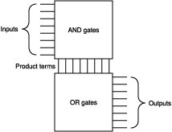
PROGRAMMABLE LOGIC ARRAY
A programmable integrated circuit – implements sum-of-products circuits (allow multiple outputs).
2 stages
AND gates = product terms
OR gates = outputs
Connections between inputs and the planes can be ‘burned’.

Slide 20
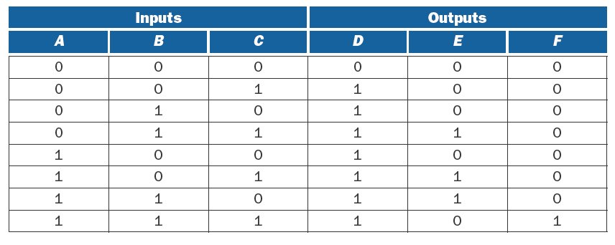
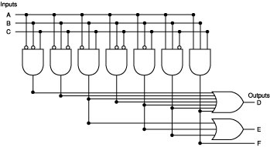
PLA EXAMPLE (1/2)

Slide 21
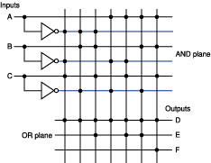
PLA EXAMPLE (2/2)
Simplified representation of previous PLA.

Slide 22
READ ONLY MEMORY (ROM)
Similar to PLA
Set of inputs (called addresses)
Set of outputs
Programmable mapping between inputs and outputs
Fully decoded: able to implement any mapping.
In contrast, PLAs may not be able to implement a given mapping due to not having enough minterms.
Notes:
Exponential number of possible minterms

Slide 23
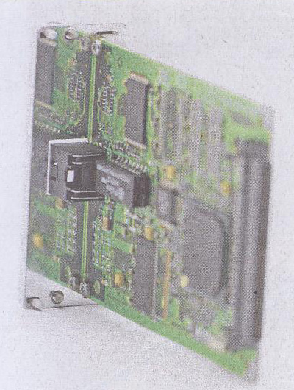

INTEGRATED CIRCUIT (IC) CHIP
Vcc = 5v
Example of a 74LS00 chip: Quad NAND gates.
1
2
3
4
14
13
12
11
10
9
8
5
6
GND
7

